Slide 1
Deep Learning-Based Systems for Detecting Hate Speech and Offensive Language in Texts

Slide 2
Abstract
This project presents a Deep Learning-Based System for detecting Hate Speech and Offensive Language in text using NLP and Transformer Models (BERT). The system processes textual data, classifies content as hate speech or non-hate speech, and ensures accurate identification of harmful language. It leverages pretrained deep learning models, advanced text preprocessing techniques, and real-time prediction capabilities. The system is designed for integration into social media platforms and online forums to promote safer digital interactions. Performance evaluation shows high accuracy, making it a reliable solution for automated content moderation.

Slide 3
Introduction
Hate speech and offensive language on online platforms have become a major concern, requiring automated detection systems for effective moderation. This project utilizes Deep Learning and Natural Language Processing (NLP) to classify text as hate speech or non-hate speech. Transformer-based models like BERT are used to enhance accuracy in detecting harmful content. The system undergoes text preprocessing, tokenization, and deep learning-based classification to identify offensive language. It can be implemented in social media, forums, and content moderation systems for real-time filtering. By leveraging large-scale datasets and advanced AI models, the system ensures high precision and reliability. This approach helps create a safer and more inclusive digital environment.

Slide 4
Existing System
Current hate speech detection systems primarily rely on rule-based methods and traditional machine learning models like SVM and Naïve Bayes. These approaches use keyword matching and basic linguistic features but struggle with context understanding. Many systems have high false positives and negatives, leading to inaccurate moderation. They lack the ability to detect implicit hate speech, sarcasm, and evolving offensive language. Additionally, traditional models require manual feature engineering, making them less efficient for large-scale data. Most existing systems do not generalize well across different languages and platforms. Due to these limitations, there is a need for a more advanced deep learning-based approach.

Slide 5
Proposed System
The proposed system leverages Deep Learning and NLP techniques to accurately detect hate speech and offensive language in text. It utilizes transformer-based models like BERT for contextual understanding, reducing false positives and negatives. Advanced text preprocessing, tokenization, and embedding techniques enhance model accuracy. The system can identify implicit hate speech, sarcasm, and evolving language patterns. It supports real-time analysis for social media platforms, forums, and online communities. The model is trained on large-scale datasets, ensuring better generalization across different domains. This approach provides a highly accurate and scalable solution for automated content moderation.

Slide 6
LITERATURE REVIEW
Various studies have explored hate speech detection using machine learning and NLP techniques. Early approaches relied on rule-based systems and statistical models like Naïve Bayes and SVM, but they lacked contextual understanding. Recent research focuses on deep learning models, such as CNNs, RNNs, and transformer-based architectures like BERT, which improve accuracy. Studies highlight challenges like bias in training data, multilingual detection, and sarcasm identification. Several benchmark datasets, including Twitter and Reddit hate speech corpora, have been used for model training and evaluation. The literature emphasizes the need for robust, scalable, and context-aware detection systems.

Slide 7
Modules for PPT:
1️⃣ Data Preprocessing:
Text cleaning, tokenization, stopword removal, and lemmatization.
Handling misspellings, slang, and special characters for better text representation.
2️⃣ Feature Extraction & Classification:
Converting text into numerical representations using TF-IDF, word embeddings, or BERT embeddings.
Training deep learning models (e.g., BERT, LSTM) for hate speech classification.
3️⃣ RGB Composite & Band Selection:
Enhancing text analysis using sentiment scoring, topic modeling, and contextual embeddings.
Identifying key linguistic patterns for improved classification accuracy.
4️⃣ Interactive Visualization:
Displaying real-time analytics using dashboards and word clouds, heatmaps, and confusion matrices.
Graph-based insights to understand hate speech trends and language patterns.
5️⃣ Model Deployment & Performance Analysis:
Deploying the trained model using Flask, FastAPI, or cloud services for real-time hate speech detection.
Evaluating performance using precision, recall, F1-score, and ROC-AUC metrics.

Slide 8
Algorithms Used :
1️⃣ Convolutional Neural Networks (CNNs):
Used for feature extraction from text embeddings, capturing spatial patterns in word sequences.
Effective for classifying hate speech by detecting contextual dependencies in text.
2️⃣ Principal Component Analysis (PCA):
Dimensionality reduction technique to improve computational efficiency.
Helps in selecting the most important linguistic features while reducing noise.
3️⃣ Softmax Classifier:
Used in the final classification layer to compute probability scores for different text categories.
Helps in multi-class hate speech detection with better interpretability.
4️⃣ Data Augmentation Techniques:
Techniques like synonym replacement, back translation, and random word deletion improve model robustness.
Helps in reducing data bias and enhancing model generalization for unseen text samples.
5️⃣ Adam Optimizer & Cross-Entropy Loss:
Adam Optimizer ensures faster convergence and stable model training.
Cross-Entropy Loss is used as the loss function for effective classification of hate speech categories.

Slide 9
Software Components:
Programming Language: Python (Efficient for NLP & Deep Learning tasks)
Frameworks & Libraries:
TensorFlow/Keras or PyTorch – For building and training deep learning models
OpenCV – (If image processing is involved) For text preprocessing and visual analysis
Scikit-learn – For machine learning models, evaluation metrics, and feature extraction
Pandas & NumPy – For handling and processing large text datasets efficiently
Matplotlib & Seaborn – For data visualization, performance graphs, and analysis
Hardware Components:
Processor: Intel i7 / Ryzen 7 or higher (For faster model training & execution)
RAM: Minimum 16GB (Recommended for handling large NLP datasets)
Storage: At least 512GB SSD (For faster data processing & model storage)
GPU (Highly Recommended): NVIDIA RTX 3060 or higher (For deep learning acceleration)
Cloud GPU (Optional for Deployment): Google Colab Pro / AWS EC2 / Azure ML (For large-scale model training)

Slide 10
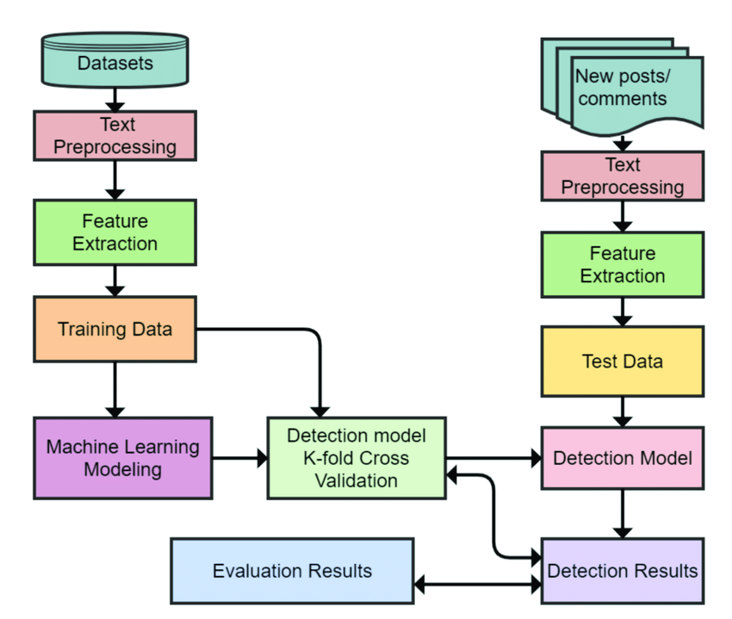
Block Diagram

Slide 11
UML Diagrams
Use Case Diagram
Data Flow Diagram
Sequence Diagram
State Diagram

Slide 12
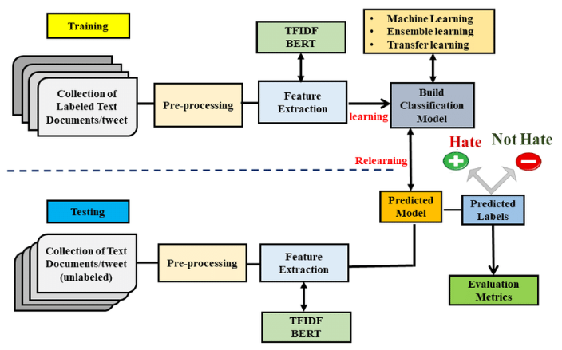
Use case Diagrams

Slide 13
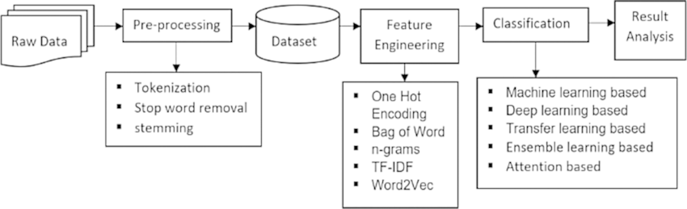
Data Flow Diagrams

Slide 14
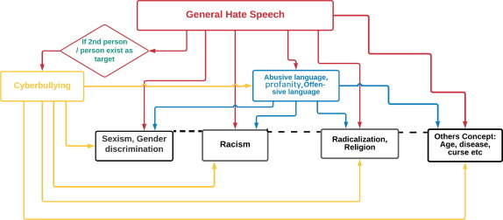
Sequance Diagrams

Slide 15
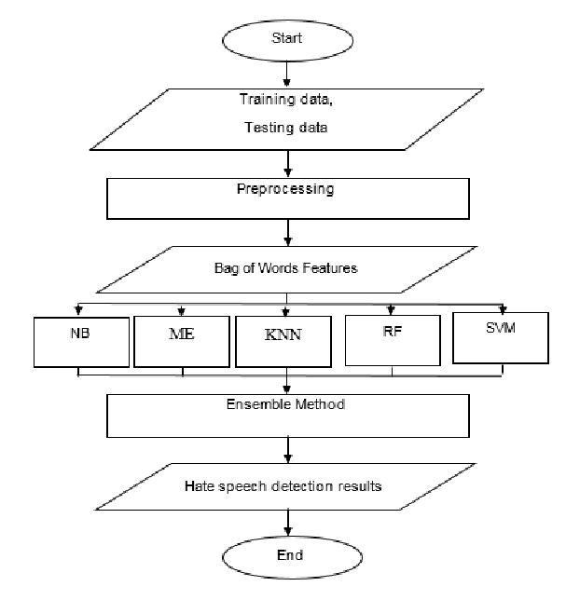
Active Diagrams

Slide 16
Final Output
The Deep Learning-Based Hate Speech and Offensive Language Detection System successfully classifies text into hate speech, offensive language, or neutral speech with high accuracy. Using NLP techniques and transformer models like BERT, the system efficiently analyzes textual data from various sources, including social media, forums, and online discussions. The final output includes a real-time detection dashboard, where users can input text and receive an instant classification result. The model's performance is evaluated using precision, recall, F1-score, and confusion matrices, ensuring reliable and fair detection. This system can be deployed as a web-based or API-based solution for seamless integration into content moderation platforms, contributing to a safer and more responsible digital environment.

Slide 17
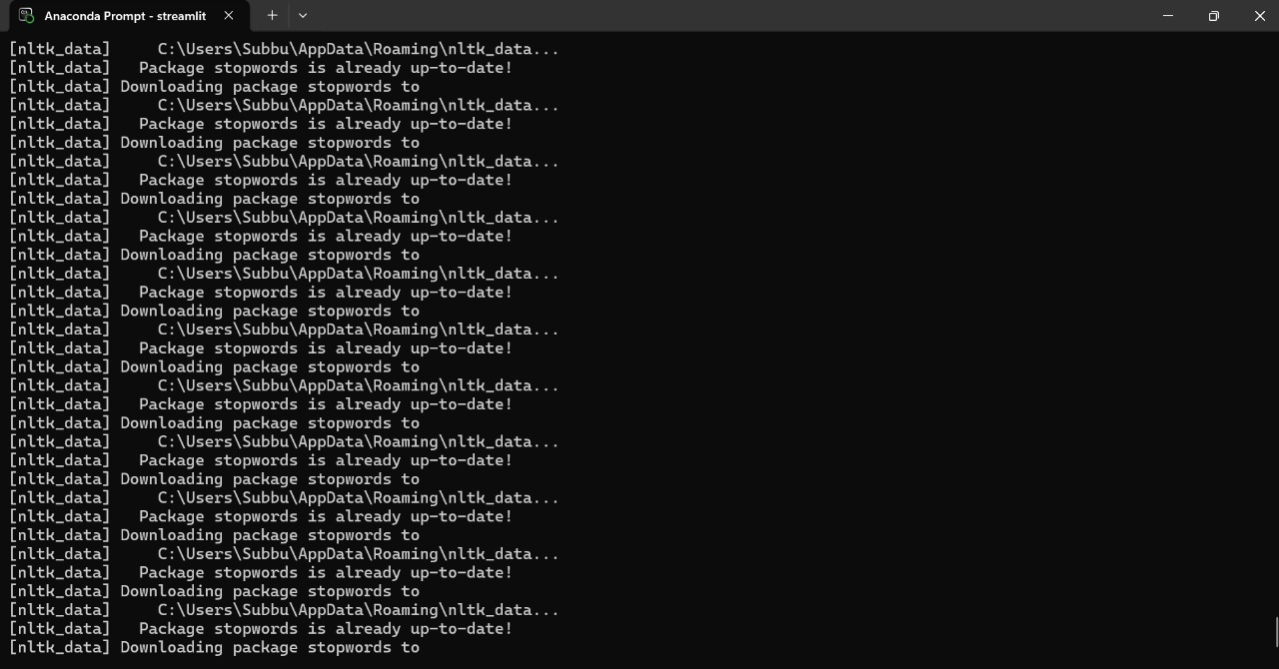
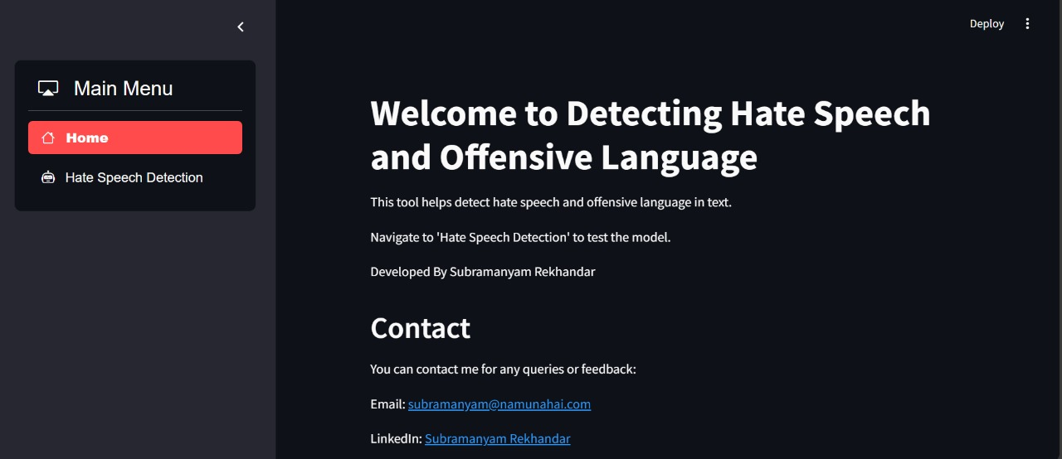
Final Output

Slide 18
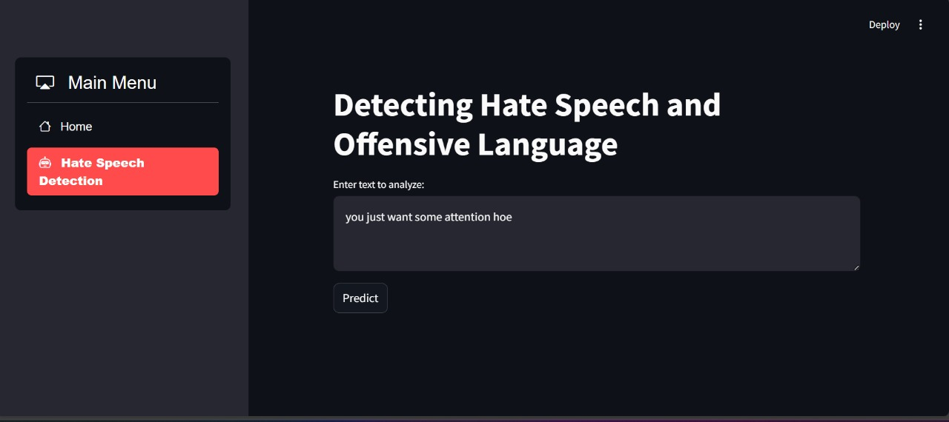
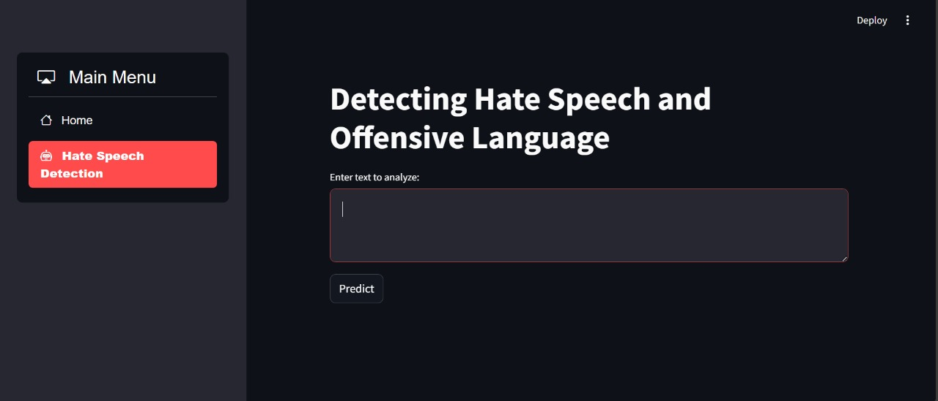
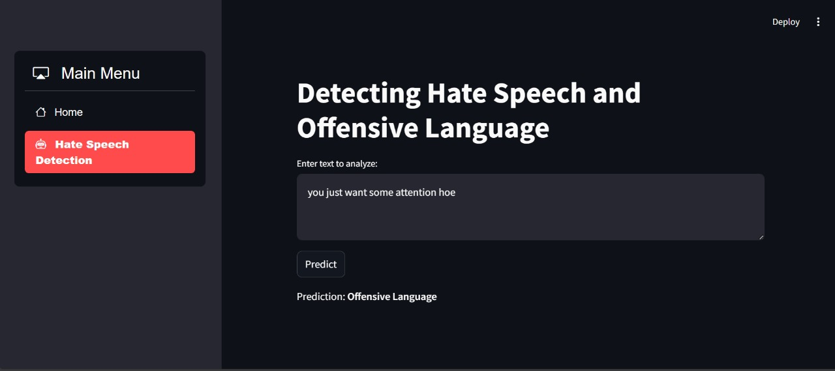
Final Output

Slide 19
Conclusion
The Deep Learning-Based Hate Speech and Offensive Language Detection System provides a robust solution for moderating harmful content across digital platforms. By leveraging advanced NLP techniques and transformer models like BERT, the system offers high accuracy, scalability, and real-time detection capabilities. It effectively handles challenges such as contextual understanding, sarcasm, and implicit hate speech, ensuring comprehensive classification. This project demonstrates the potential of deep learning models in tackling social issues related to online hate speech, providing a safe, inclusive online environment. Future improvements could focus on enhancing model adaptability across languages, expanding datasets, and optimizing deployment in real-world scenarios.

